Slide 1

Employee Survey Analysis
Patrick Chase

Slide 2
Survey Information
Agencies of Focus
Dept of Widget Makers
Gizmo & Gadget Partnership
Contraption Commission
Thingamajig Commission
Information Collected
demographic information
responses to questions about satisfaction, culture, etc.
Notes:
Collected demographic information and responses to questions about satisfaction, culture, etc.

Slide 3
Focus of this Analysis
Assess workforce morale
Identify highlights and areas of improvement
Recommendations

Slide 4
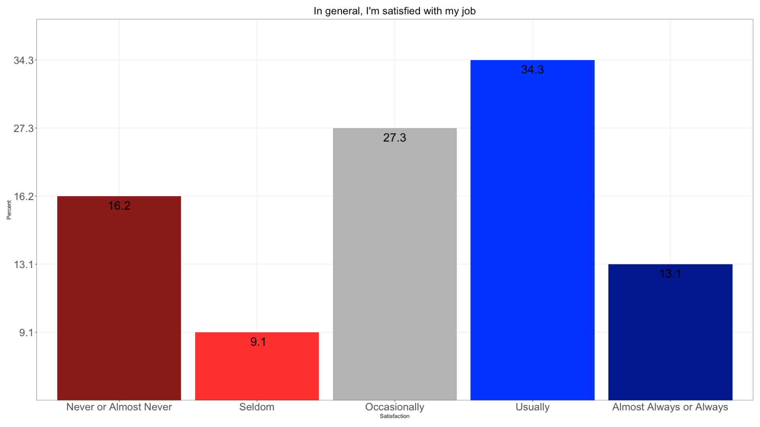
Job Satisfaction

Slide 5
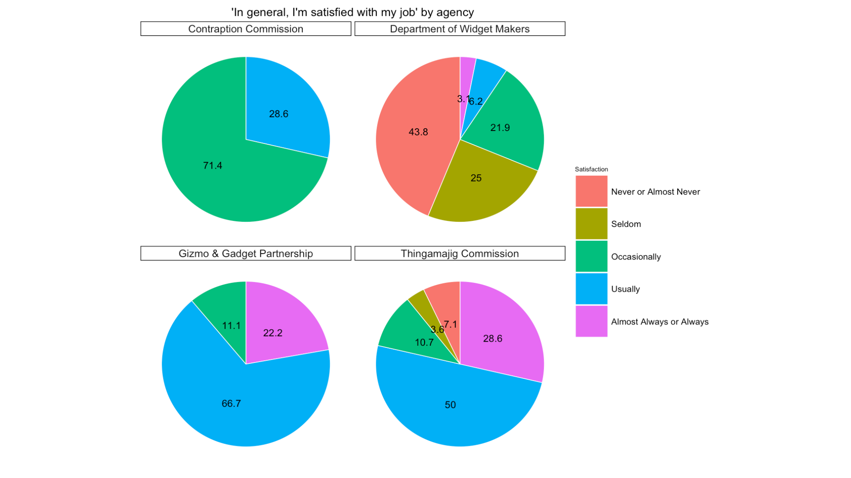
Job Satisfaction by Agency

Slide 6
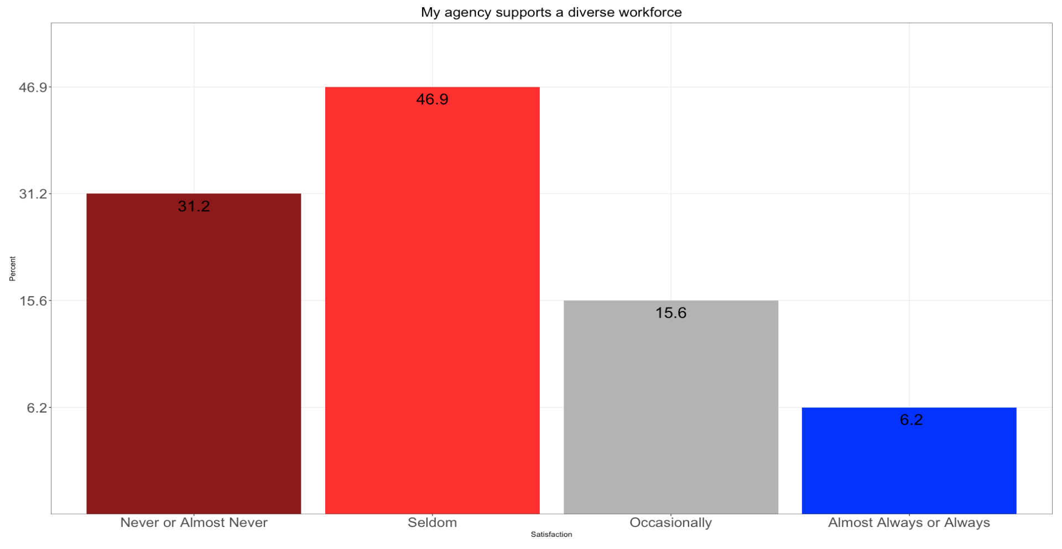
Department of Widget Makers

Slide 7

Department of Widget Makers

Slide 8

Department of Widget Makers

Slide 9
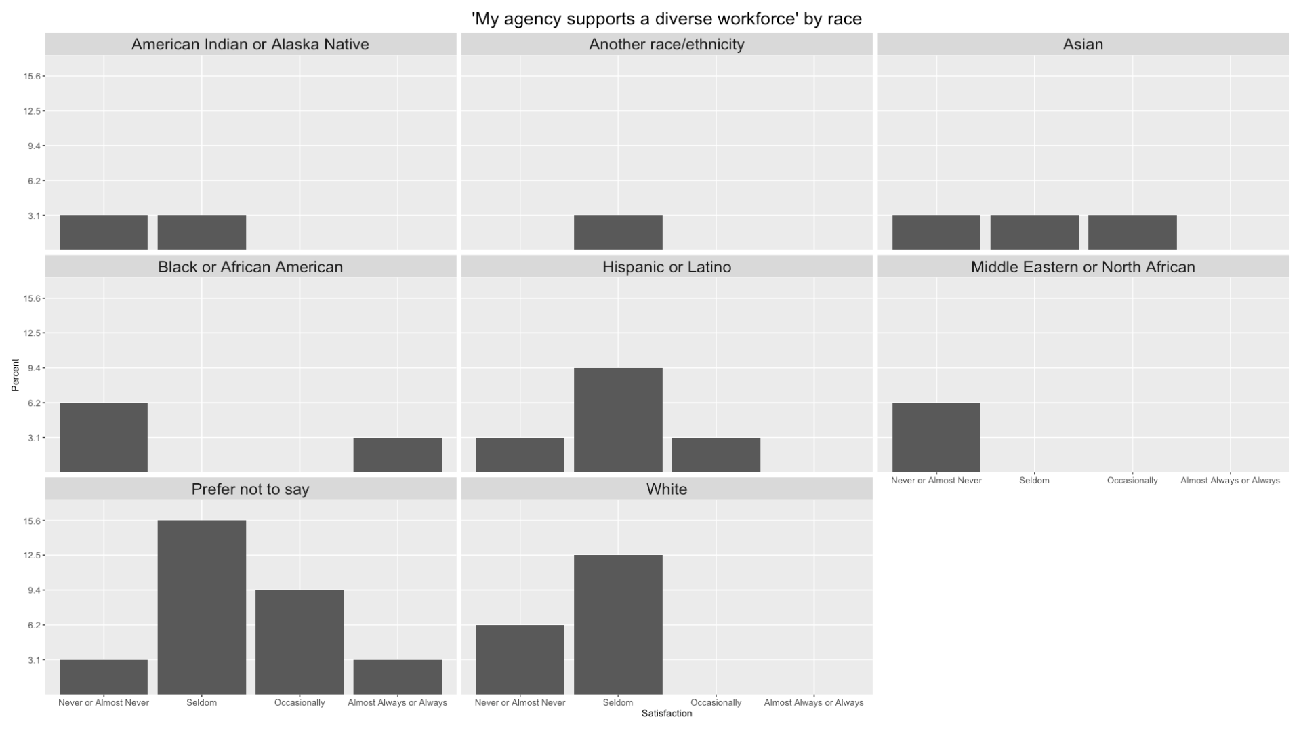
Department of Widget Makers

Slide 10
Recommendations

Slide 11
Appendix
This presentation and additional analysis can be found at this link
Examine my code, replicate my work, or view further insights

Slide 12
Questions

Slide 13
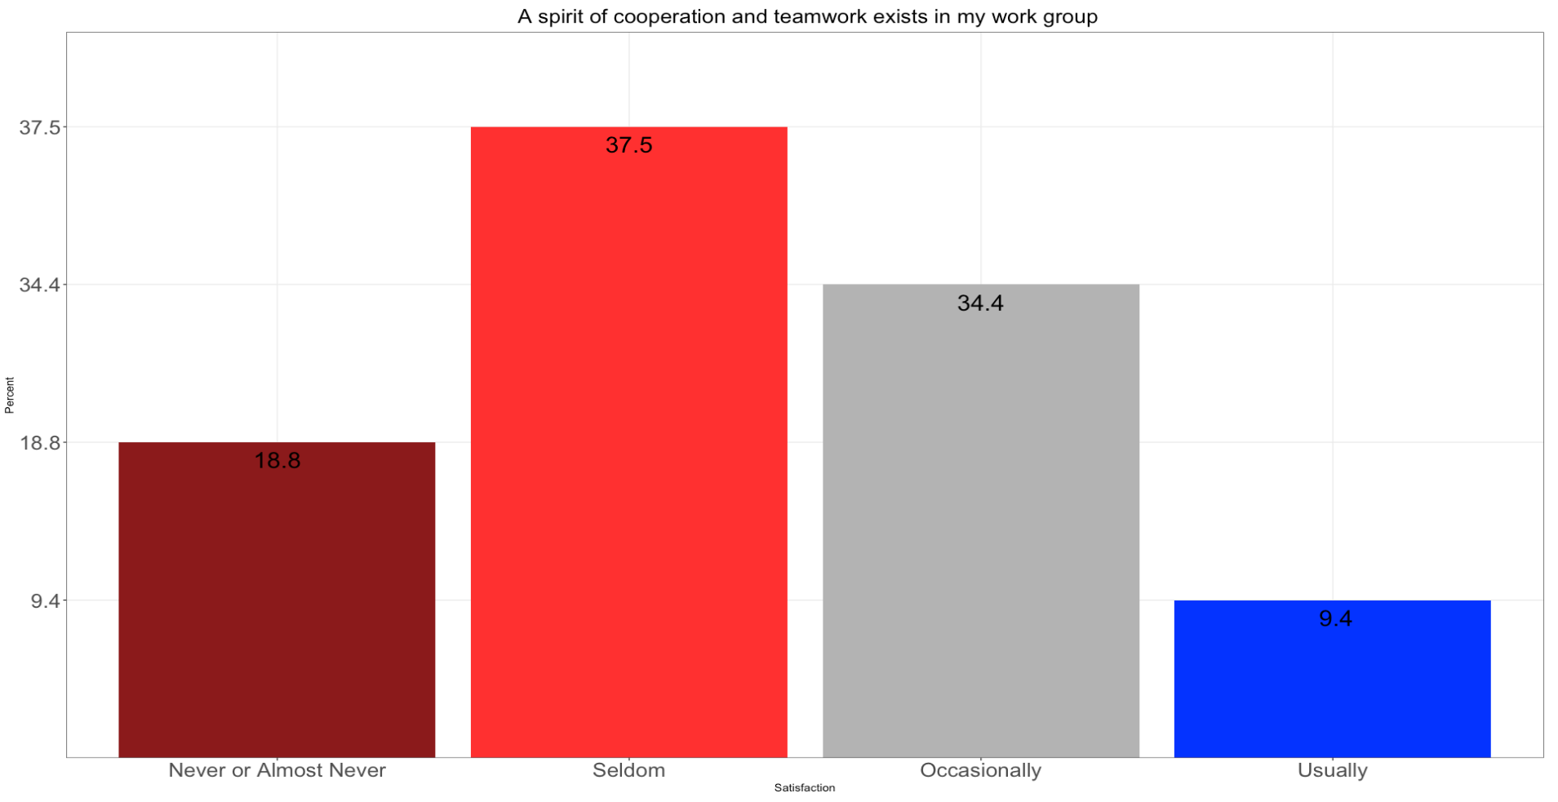
Department of Widget Makers

Slide 14
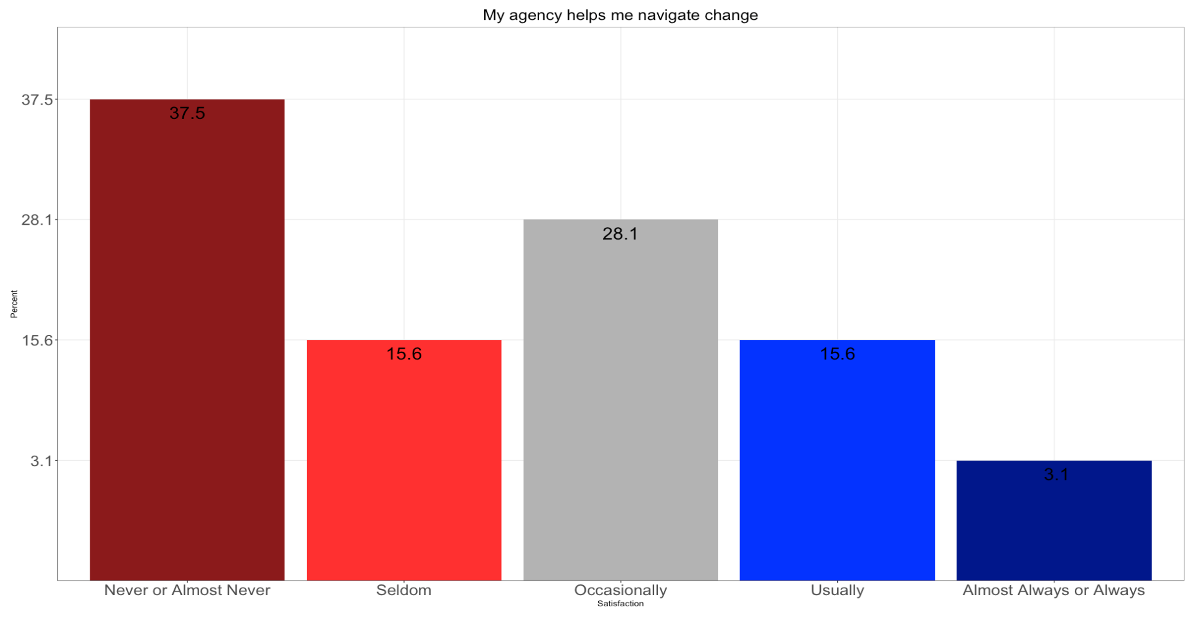
Department of Widget Makers

Slide 15
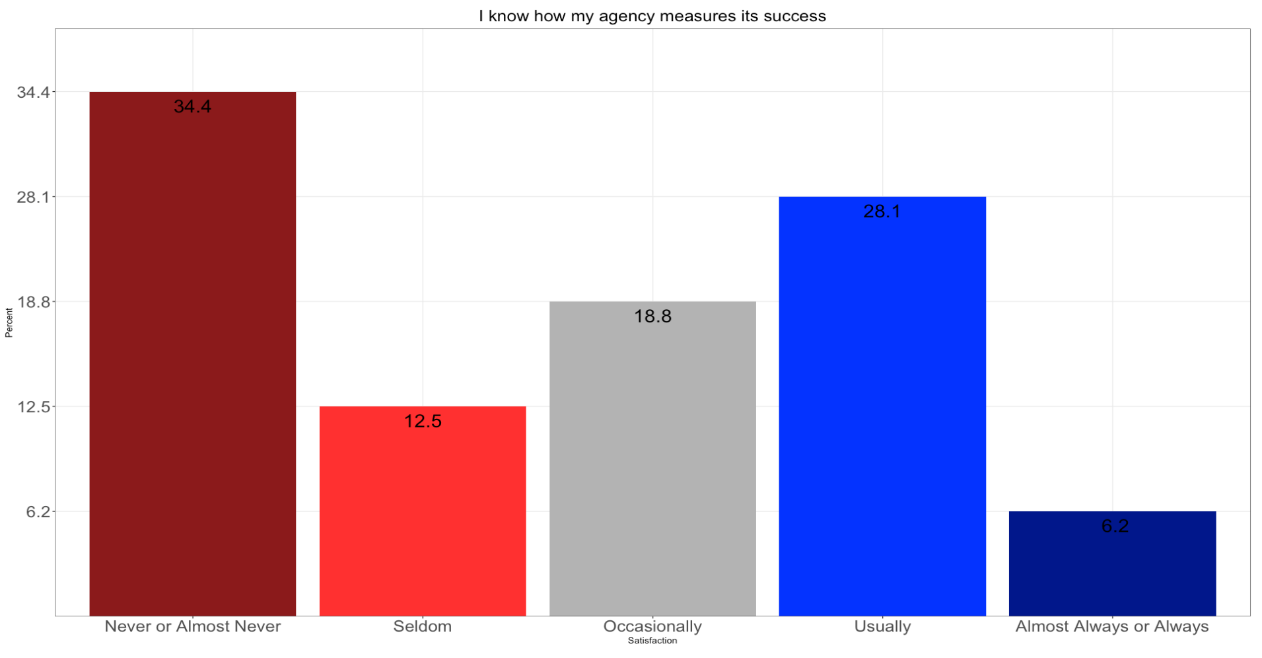
Department of Widget Makers

Slide 16
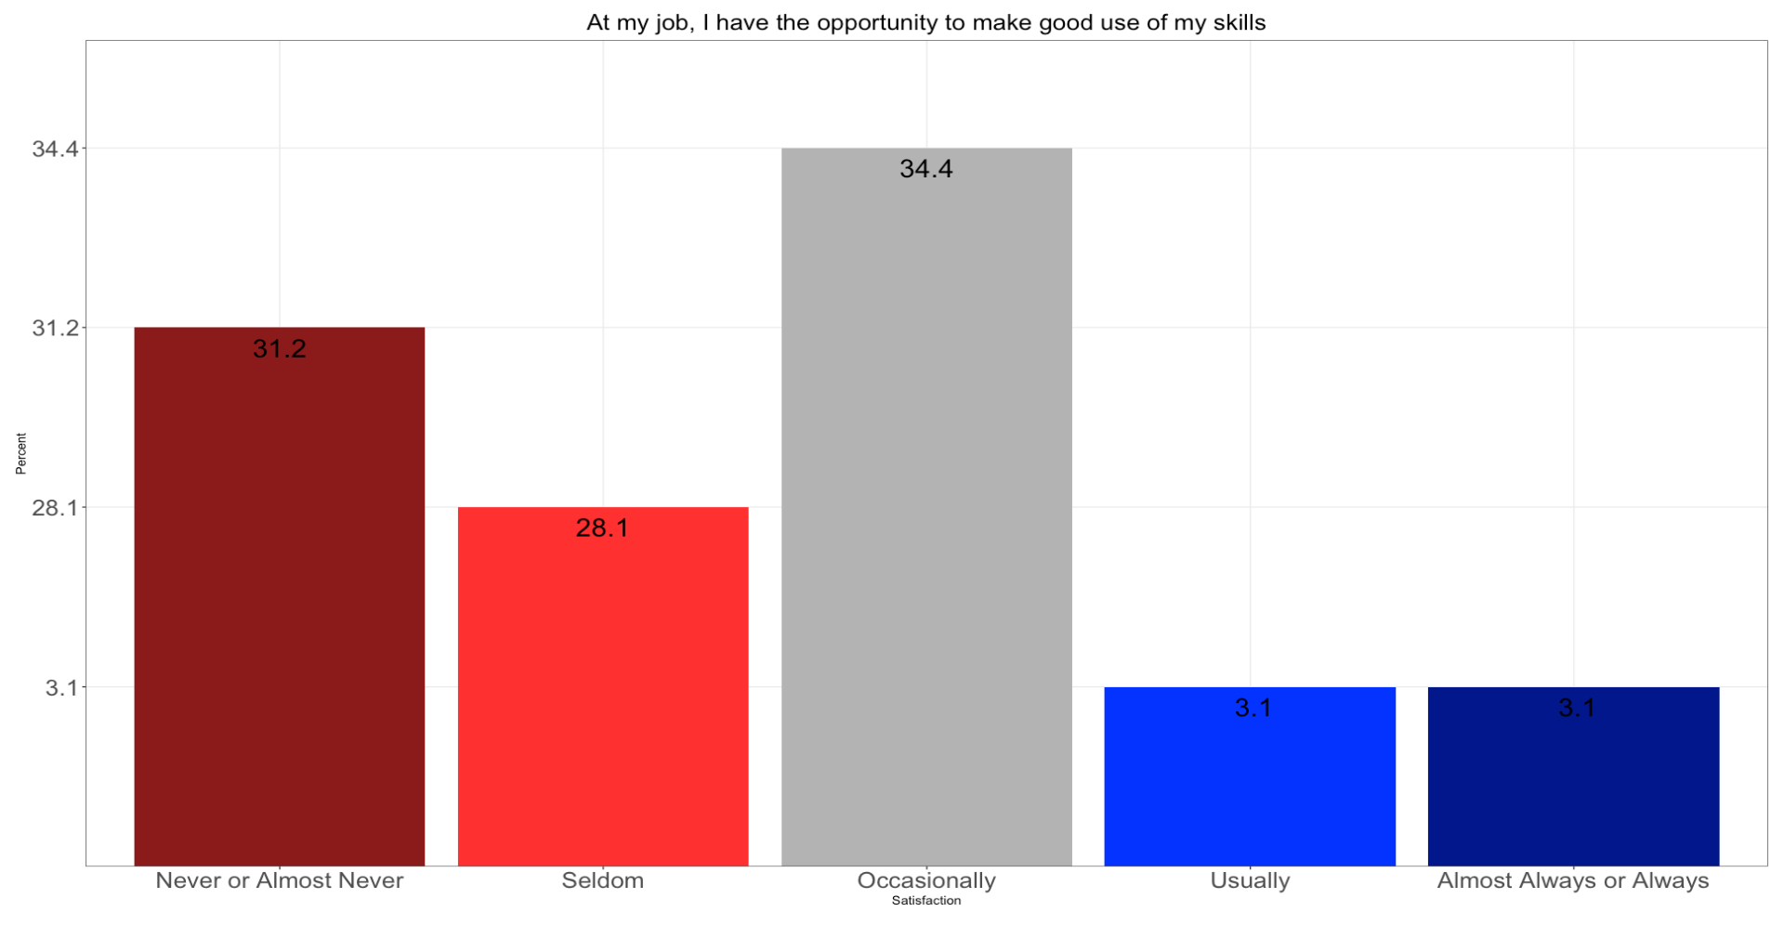
Department of Widget Makers

